Slide 1

Hello,
Release 1

Slide 2
Code Name: Raphael

Slide 3
AI Chat Bot for FAQs
SSAD 03
Client: Mr. Jayanth Rasamsetti
Gibbr
Mentor: Sourav Sarangi
Team: Anubhab Sen, Vighnesh Chenthil Kumar, Ananya Trivedi

Slide 4
Searching for answers to all our questions on the FAQ section of websites can get really tiresome.
We need to scroll through a list of questions and answers, whether relevant or irrelevant.
PROJECT PROBLEM STATEMENT

Slide 6
Typical response by customer care execs

Slide 7


Slide 8
Usefulness of current FAQ sections

Slide 9
Less is More

Slide 10
The process of searching for answers on FAQ pages can be automated by using a smart bot, powered by AI, which could be fed a set of questions, and programmed to provide the most relevant answer required by the user.
OUR ANSWER

Slide 12
Retaking the survey
The survey was repeated. This time with people knowing our intended solution. The same set of people were once again asked if the text FAQ sections are useful.

Slide 13
Usefulness of current FAQ sections

Slide 14

AI meets FAQ

Slide 15
Technologies Used

Slide 17
Demo

Slide 18
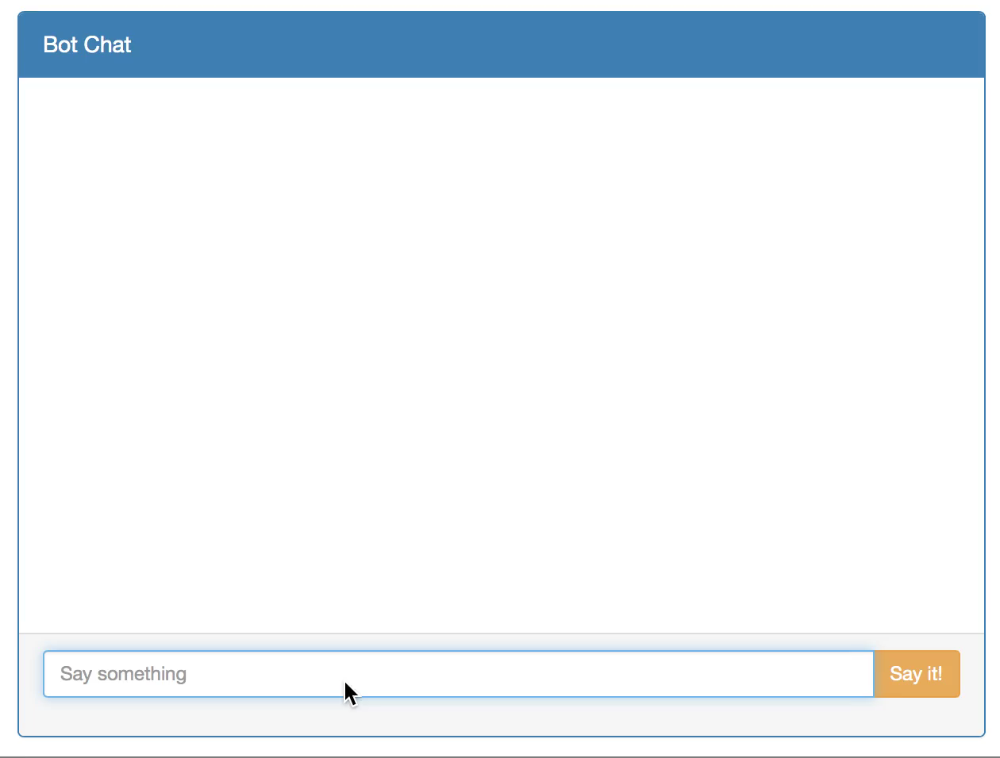

Slide 19
Milestones
Kick Off
Concept
Plan
Create an
interactive
front end
Train the
bot with
FAQs
Release 1

Slide 20
Release 2
Continue
from R1
Plan
Provide
‘the button’
for human
interaction
Other
release 2
features
Deploy on
field
Release 2

Slide 21
Future Scope

Slide 22
Human fallback
A.I. ain’t perfect

Slide 23
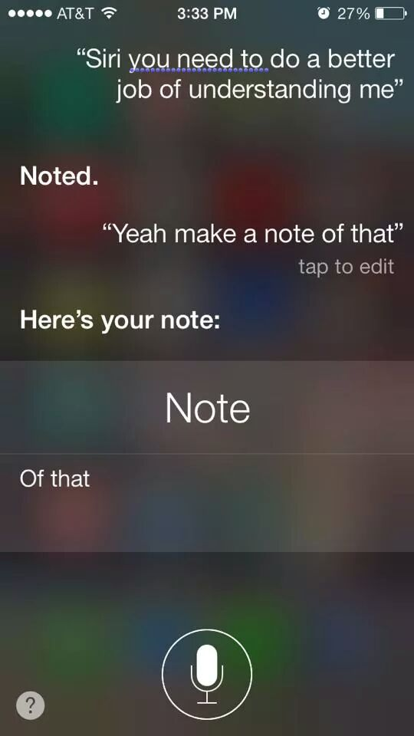
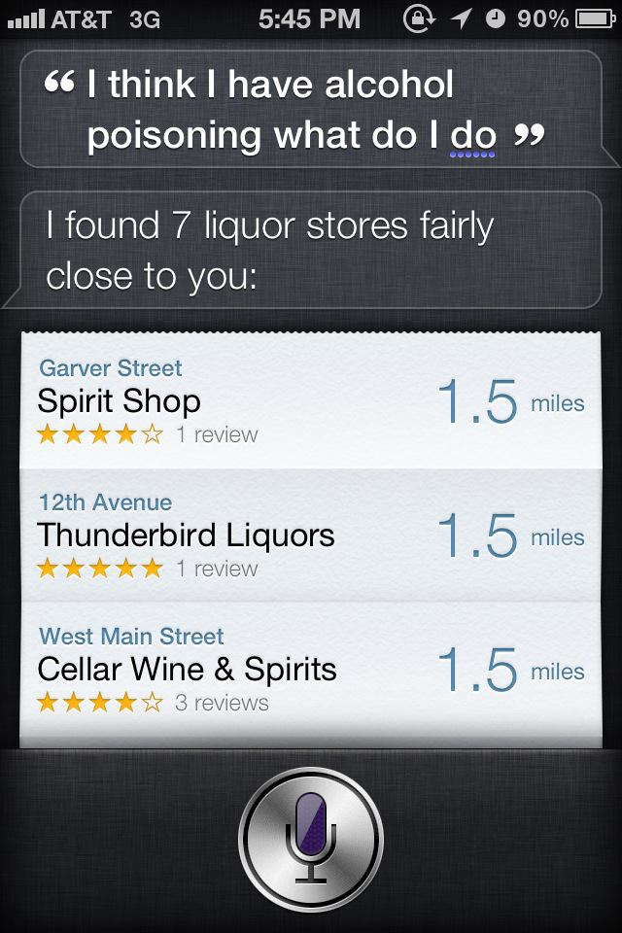
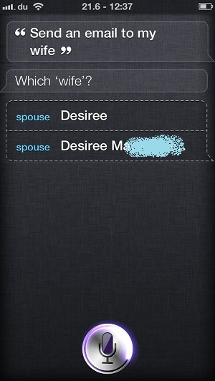

Slide 25

Our Solution
Big Red
Button
Get me a human!!

Slide 26
What's Next
Customise bot for individual businesses
Extract information from user in a friendly manner
Bot provides recommendation

Slide 27
Coming Soon

